Slide 1

May - 2026 Department of Mechanical Engineering Visvesvaraya National Institute of Technology Nagpur
Project Phase 2 : Seminar 3
Biomechanical Comparison of Implants for Intertrochanteric Fracture Fixation Using Stress Analysis
Name of Student | Enrolment No.
Aditi Verma | BT22MEC002
Sanskriti Rathore | BT22MEC010
Name of Guide
Dr. Rashmi Uddanwadikar

Slide 2


Acknowledgement
We would like to express our sincere gratitude to Dr. Chandak and Dr. Pahukar for their invaluable guidance and support towards our project, titled "Biomechanical Comparison of Implants for Intertrochanteric Fracture Fixation Using Stress Analysis"
Dr. Chandak and Dr. Pahukar's expertise in the field and their insightful ideas provided the foundation for this research. We are especially thankful for the data and resources they provided, which were essential for this project.
2 / 10

Slide 3
Contents
Introduction
Objectives of Project
Outcomes of Literature Survey
Modelling
Analysis
Results
Comparison and Conclusion
References
2 / 10

Slide 4
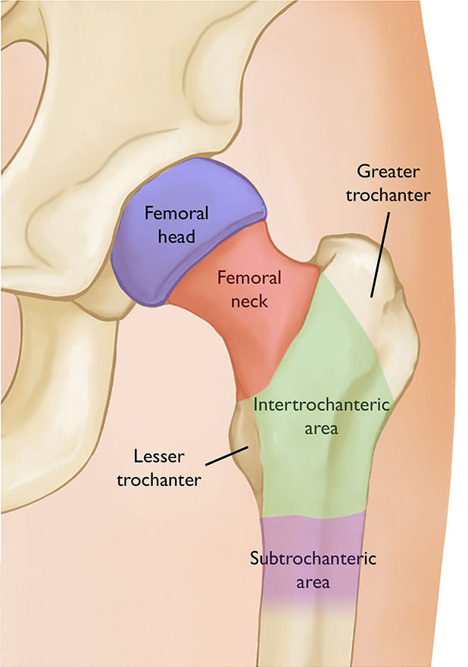
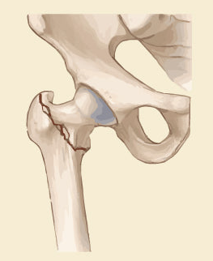
Introduction
Intertrochanteric Fracture
Occurs between greater and lesser trochanter of femur.
Common in elderly (osteoporosis, falls) but also in high-energy trauma in young adults.
Challenges: poor bone quality, high shear forces, risk of fixation failure.
Types of Fixation Implants:
Extramedullary Implants
Intramedullary Implants

Slide 5
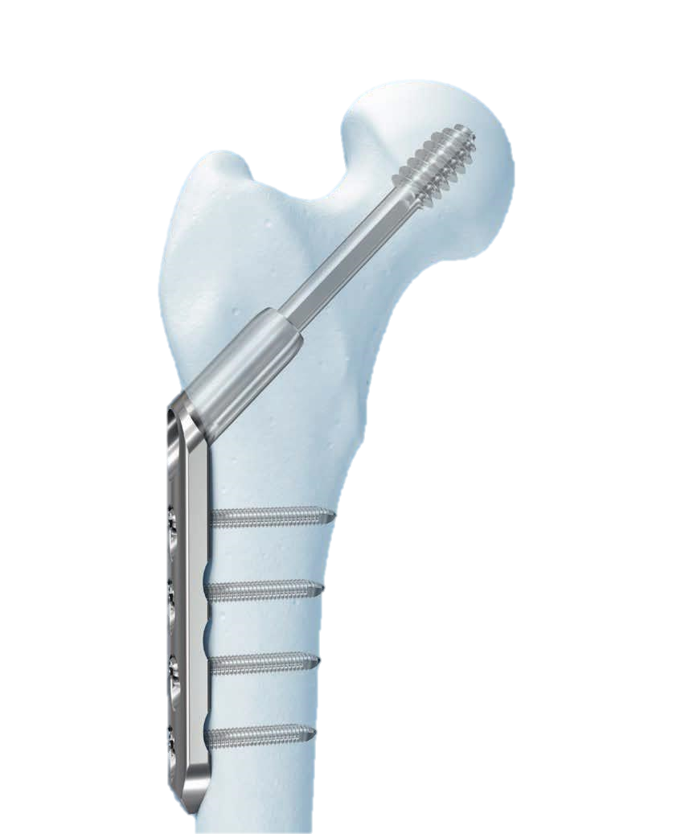
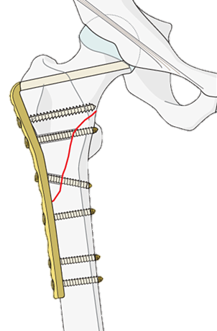
Extramedullary Implants
Extramedullary fixation of hip fractures refers to the application of a plate and screws to the lateral side of the proximal femur
Benefits: easy technique, cost-effective, effective for stable fractures.
Examples:
DHS (Dynamic Hip Screw)
Provides stable fixation for intertrochanteric fractures.
Angled Blade Plate
Provides strong angular stability due to the fixed angle between plate and blade/screw.

Slide 6
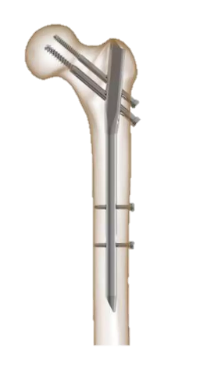
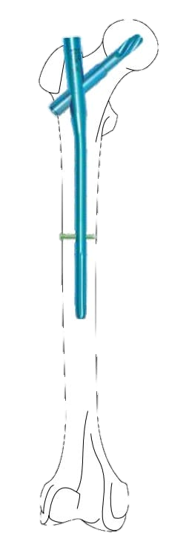
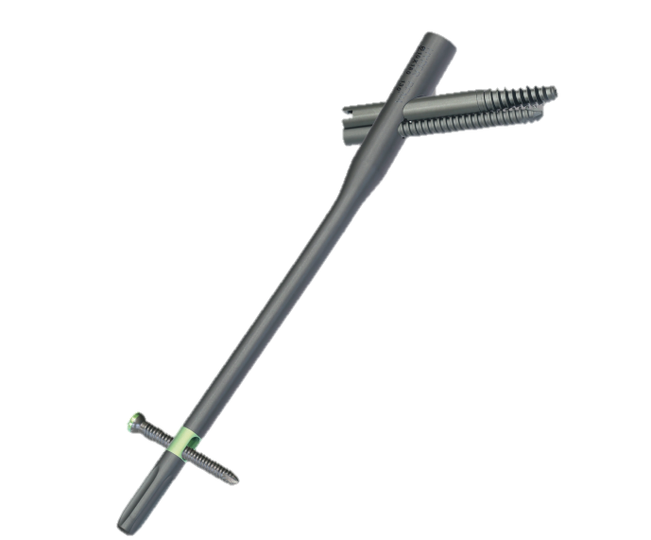
Intramedullary Implants
Intramedullary (IM) implants are metal rods inserted into the central marrow cavity (medullary canal) of femur to stabilize fractures.
Benefits: small incision, reduced blood loss, greater load sharing, better suited to unstable/multi-fragment fractures.
Examples:
PFN (Proximal Femoral Nail)
Intramedullary design gives stronger load-sharing and better biomechanical stability.
PFNA-II (Proximal Femoral Nail Antirotation II)
Helical blade provides excellent purchase in osteoporotic bone by compaction rather than excavation.
InterTAN (Intertrochanteric Antegrade Nail)
Integrated dual screw system that provides dual compression capability which reduces risk of screw migration or “Z-effect”.

Slide 7
Objectives of Project
AIM: To compare the stability and the performance of different implants for Intertrochanteric femur fractures through Finite Element Analysis.
To create a CAD model of the healthy femur bone and various implants.
Assemble the femur bone with DHS, Angled Blade Plate, PFN, PFNA- II, and InterTan implants.
Find the properties of the femur bone and implants, and the loading conditions during different activities.
Perform stress analysis simulation on each assembly.
Compare mechanical behavior against a healthy femur model.
Determine the implant with maximum stability and performance for the fracture.

Slide 8
Literature Survey
Reference details | Description of work carried out | Outcome
Tianhao Yang, Faez Noraddin, Baozhe Liu, Zegen Zhang, Hai-Lun Gu [1] October 2025 | Performed finite element analysis for implant selection and screw positioning in proximal femoral basicervical Fractures. | Their study concluded that implant geometry and screw placement play an important role in reducing stress concentration and micromotion at the fracture site. Proper screw positioning significantly improves fixation stability and decreases risk of cut-out failure.
Huang X, Yu B, Gu Y, Li Z [2] 2017 | Conducted a finite element study comparing the Dynamic Hip Screw and Gamma nail for the treatment of unstable trochanteric fractures. | Their study demonstrated that the Gamma nail exhibited lower implant stress and better load-sharing properties compared to DHS, particularly in unstable fracture patterns. The results highlighted the biomechanical superiority of intramedullary devices.
Li C-T, Chang C-W, Chen Y-N [3] March 2026 | A finite element model was developed to analyse femoral neck, intertrochanteric, and reverse intertrochanteric fractures using different implant configurations including BN, PFN-M, ITAN, PFN, and DHS under simulated walking loads. | The ITAN implant showed the highest stability for femoral neck fractures, whereas PFN-M showed better performance for reverse intertrochanteric fractures by minimizing medial and lateral fracture gap deformation.

Slide 9
Literature Survey
Reference details | Description of work carried out | Outcome
Mustamsir E, Aji AP, Fernando A [4] June 2024 | The researchers performed a registered systematic review and meta-analysis and included 10 papers with 1,149 patients (PFNA and DHS). They included Harris Hip Scores, major complication and perioperative measures with Risk of Bias assessment and sensitivity analysis. | The PFN patients experienced shorter surgery (19 min shorter), and less blood loss (89 ml less) compared with DHS. Implant failure occurred in 1.6% of PFNA cases and 3.5% of DHS cases (not a significant difference). The functional outcomes were similar.
Rogalski, Martelli, Pandy, and Kersh [5] 2025 | Studied the influence of muscle forces on strain distribution in the proximal femur using subject-specific finite element models. | Their results showed that inclusion of hip-spanning muscle forces significantly reduced abnormal strain concentrations and changed the loading mode of the femoral neck from bending to compressive loading.
Gao-Xiang Yuan, Yu-Hui Shen, Bo Chen, Wei-Bin Zhang [6] 2012 | The patients with intertrochanteric femoral fractures treated with the fixation of dynamic hip screw (DHS) were retrospectively studied. Functional outcomes, union rates, and complications were compared to evaluate the success of DHS fixation. | Most fractures healed uneventfully with high union rates. Complications were implant failure, varus deformity, and shortening of the limb, but overall DHS fixation yielded satisfactory functional and radiological results in elderly patients with intertrochanteric fractures.

Slide 10
Literature Survey
Nature of most of the studies and research papers is retrospective.
Patient Specificity & Generalizability
Loading conditions
Model simplification
Scope:
Biomechanical comparison of intertrochanteric implants using FEA under identical loading, geometry, and material assumptions.
Evaluation of stress distribution, deformation, and load-sharing behavior under fractured and healed conditions.
Comparative analysis of DHS, Angled Blade Plate, PFN, PFNA-II, and InterTAN.
Loading conditions represents one-legged stance.

Slide 11
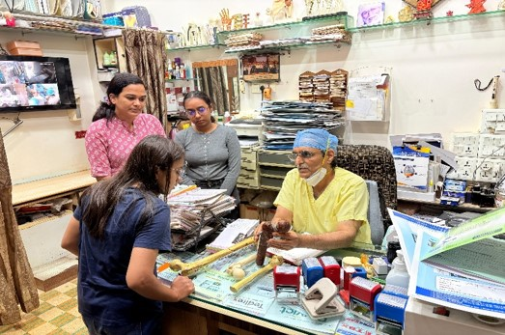
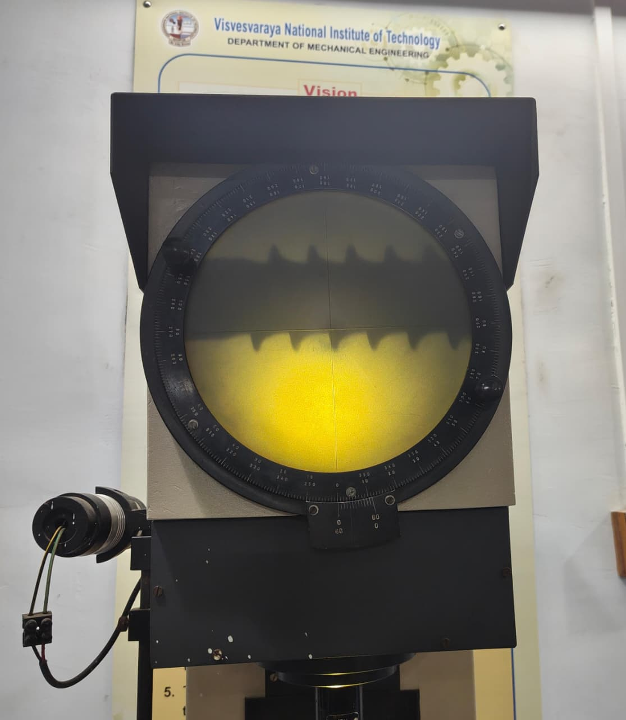
Modelling
Clinical Consultation:
Following the clinical consultation, detailed dimensional measurements of all implant components were carried out to develop accurate three-dimensional CAD models.
Clinical Consultation with Dr. Chandak
Helical screw's dimensions taken with the help of profile projector

Slide 12
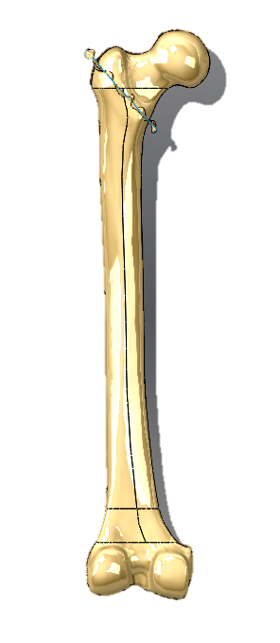
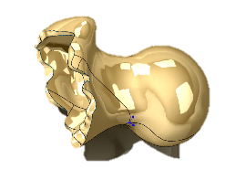
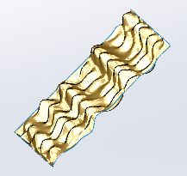
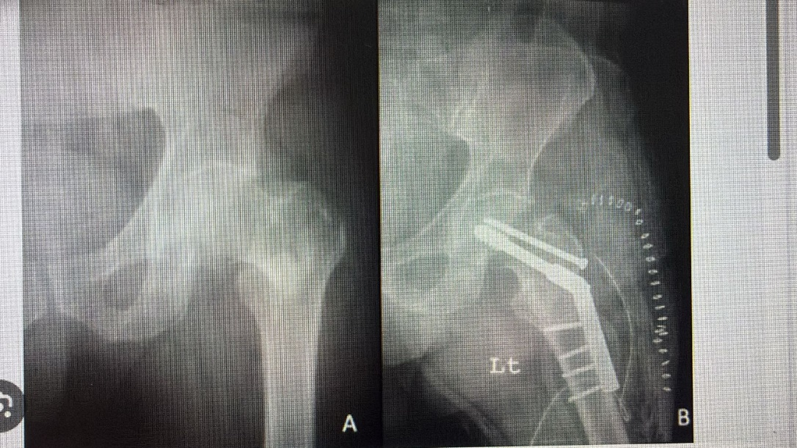
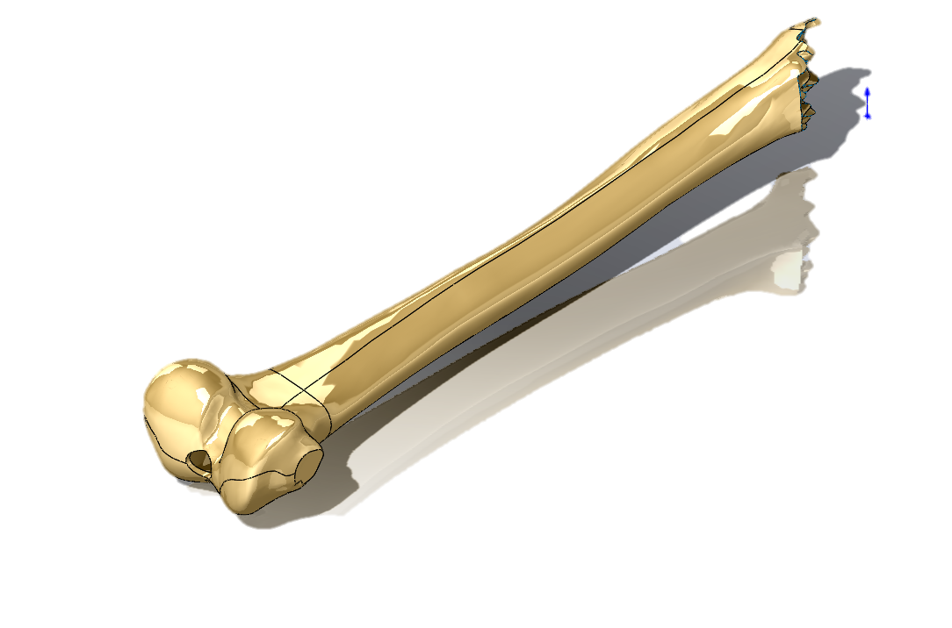
Femur Fracture Modelling:
An anatomically realistic intertrochanteric fracture was created based on orthopaedic consultation and X-ray references. A fracture plane was generated and applied to the femur model, which was then used to split the bone into two distinct fragments.
Freeform Plane modelled for Fracture
Pre-op X-ray Post-op X-ray

Slide 13
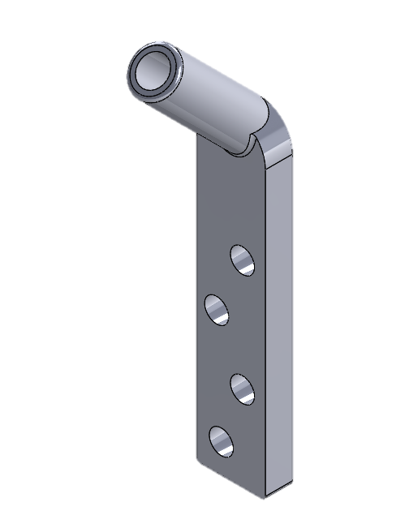
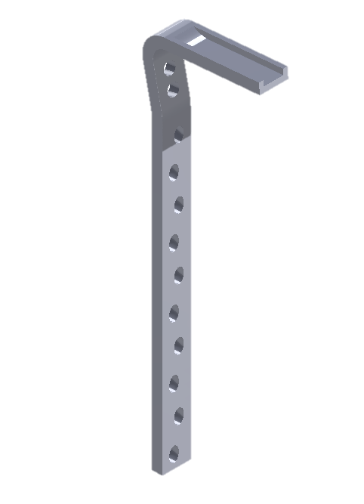
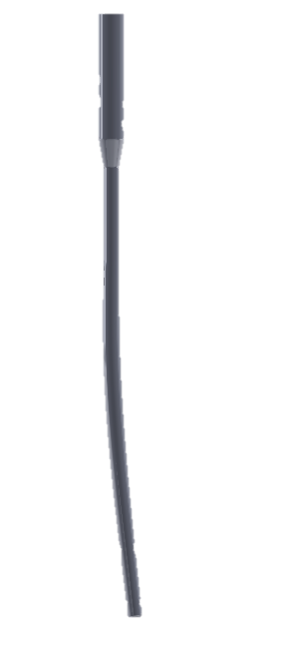
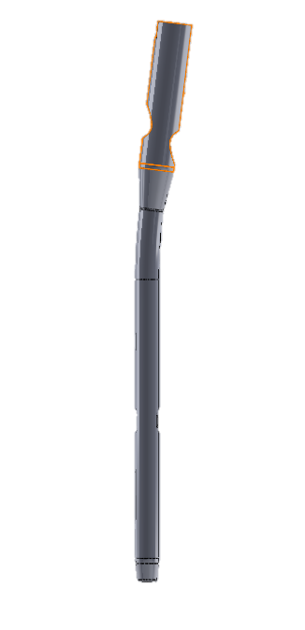
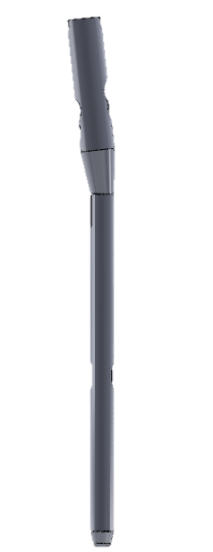
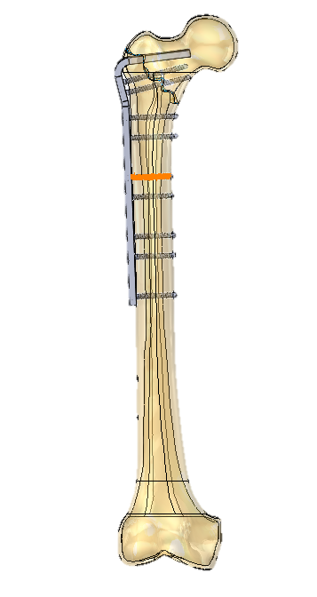
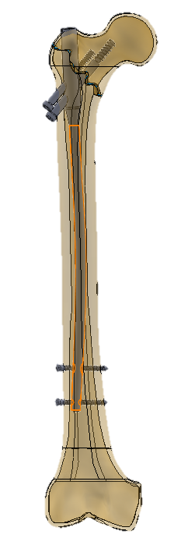
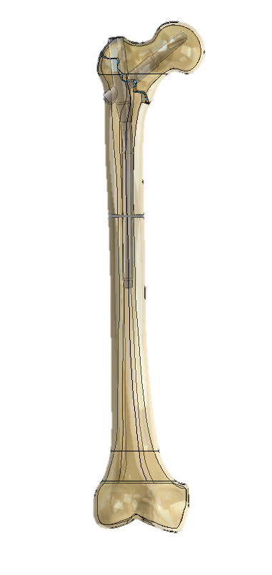
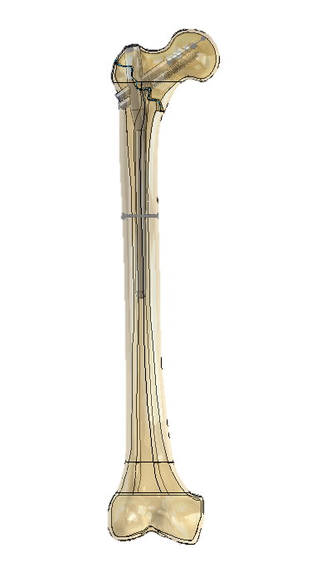
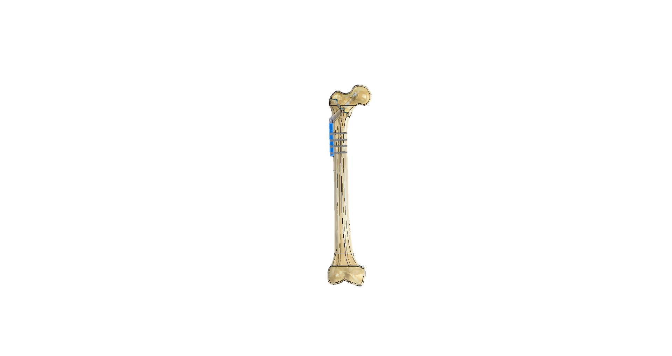
Implant Modelling and Assembling:
Intramedullary
Extramedullary
DHS Angled Blade Plate PFN PFNA-II InterTAN
Implants
Assemblies

Slide 14
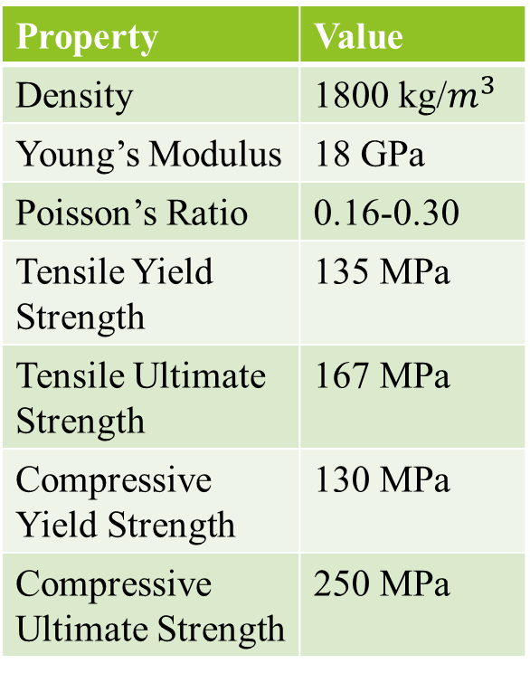
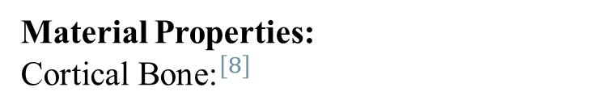
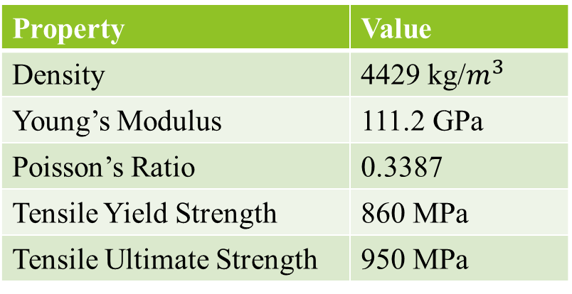
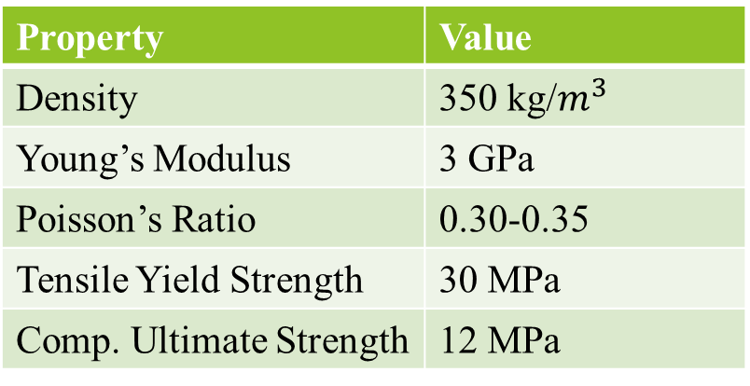
Analysis
Cancellous Bone:
Material Properties:
$${\text{Cortical} \text{Bone}\text{:}}^{[8]}$$
Property | Value
Density | 350 kg/$m^{3}$
Young’s Modulus | 3 GPa
Poisson’s Ratio | 0.30-0.35
Tensile Yield Strength | 30 MPa
Comp. Ultimate Strength | 12 MPa
Property | Value
Density | 1800 kg/$m^{3}$
Young’s Modulus | 18 GPa
Poisson’s Ratio | 0.16-0.30
Tensile Yield Strength | 135 MPa
Tensile Ultimate Strength | 167 MPa
Compressive Yield Strength | 130 MPa
Compressive Ultimate Strength | 250 MPa
Titanium Alloy (Ti-6Al-4V):
Property | Value
Density | 4429 kg/$m^{3}$
Young’s Modulus | 111.2 GPa
Poisson’s Ratio | 0.3387
Tensile Yield Strength | 860 MPa
Tensile Ultimate Strength | 950 MPa

Slide 15
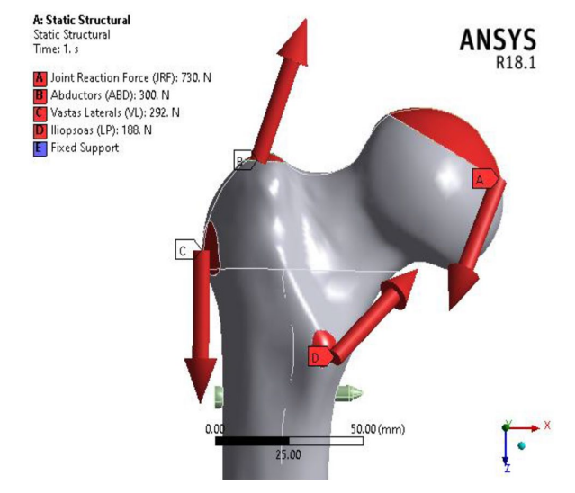
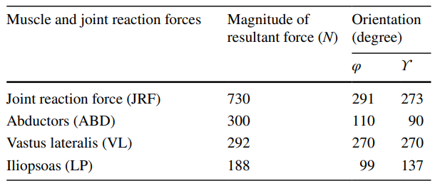
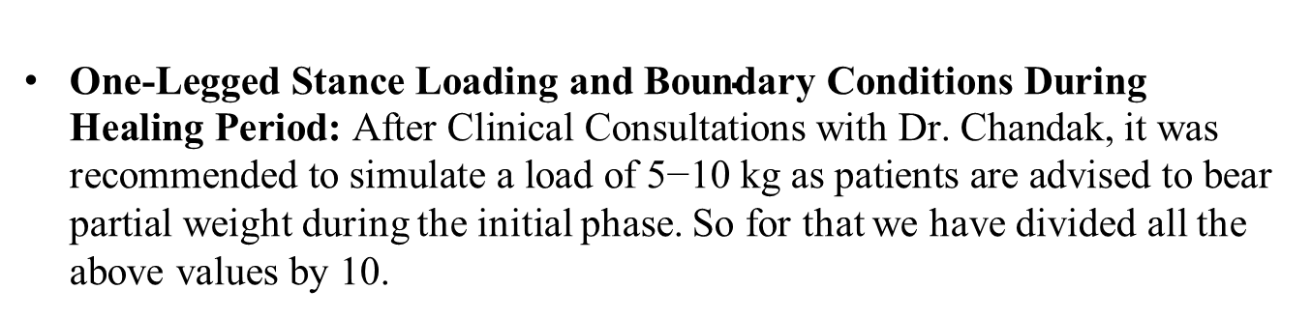
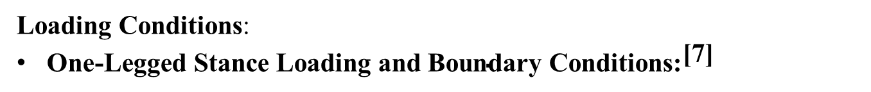
Loading Conditions:
${\text{One}\text{‑}\text{Legged} \text{Stance} \text{Loading} \text{and} \text{Boundary} \text{Conditions}\text{:}}^{\text{[}\text{7}\text{]}}$
$\text{One}\text{‑}\text{Legged} \text{Stance} \text{Loading} \text{and} \text{Boundary} \text{Conditions} \text{During} \text{Healing} \text{Period}\text{: }\text{After} \text{Clinical} \text{Consultations} \text{with} \text{Dr}\text{. }\text{Chandak}\text{, }\text{it} \text{was} \text{recommended} \text{to} \text{simulate} \text{a} \text{load} \text{of}\text{ 5−10 }\text{kg} \text{as} \text{patients} \text{are} \text{advised} \text{to} \text{bear} \text{partial} \text{weight}$ during the initial phase. So for that we have divided all the above values by 10.

Slide 16
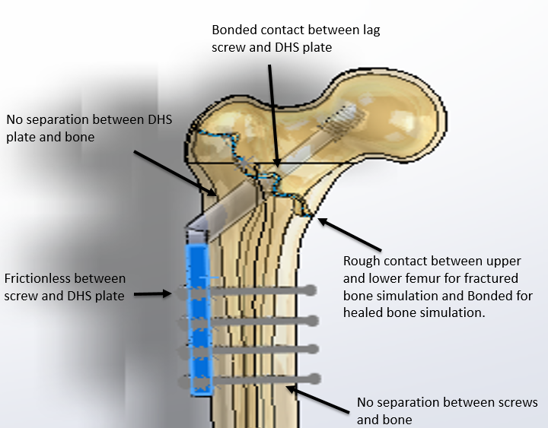
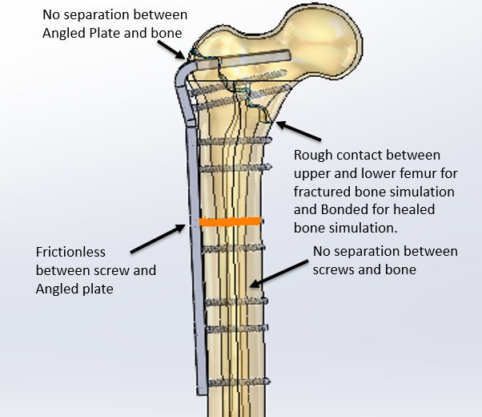
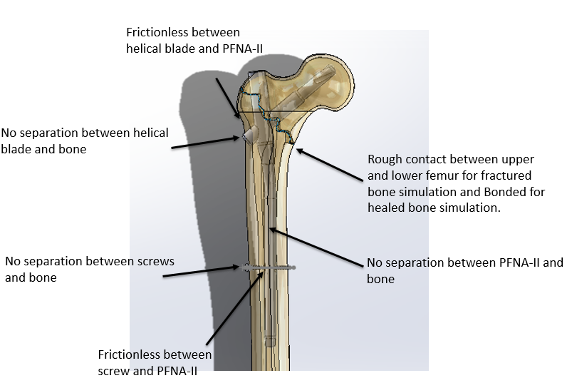
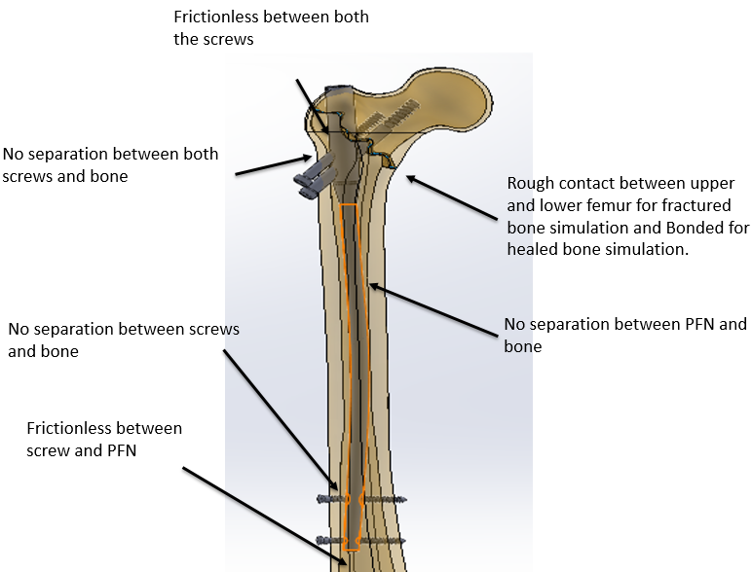
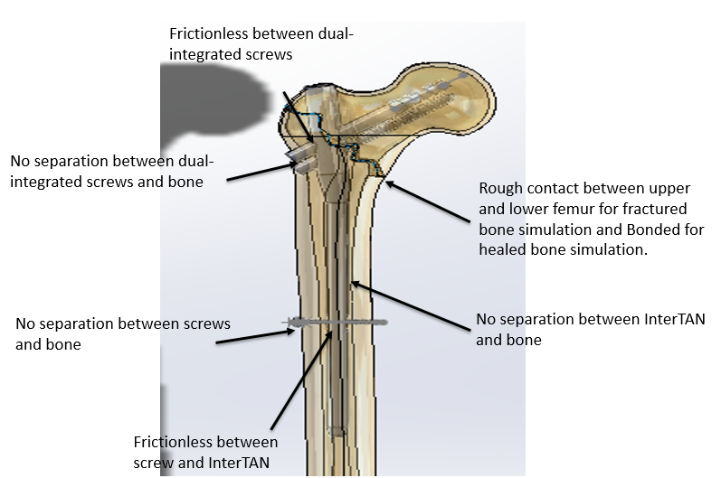
Contact Conditions:
DHS Angled Blade Plate PFN
PFNA-II InterTAN
Fixed Support

Slide 17
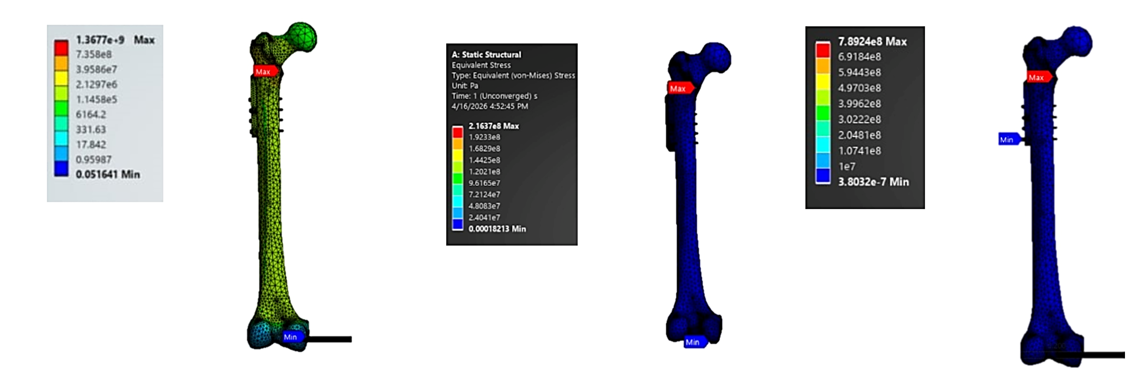
Results
DHS:
75 kg fractured: Implant stress = 638.29 MPa, Bone stress = 1.36 GPa, Average stress = 4.39 MPa
7.5 kg fractured: Implant average stress = 1.34 MPa, Bone stress = 216.7 MPa
75 kg bonded/healed: Implant stress = 789.24 MPa, Average stress = 5.80 MPa
(a) Fractured – 75 kg (b) Fractured – 7.5 kg (c) Bonded – 75 kg

Slide 18
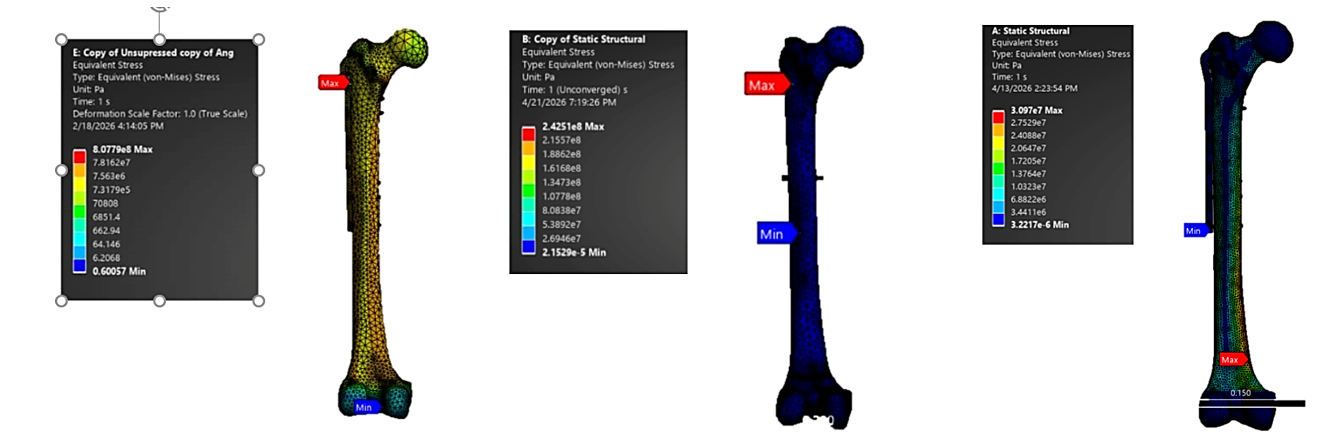
Results
Angled Blade Plate:
75 kg fractured: Implant stress = 807.79 MPa, Bone stress = 226.09 MPa, Average stress = 4.09 MPa
7.5 kg fractured: Implant stress = 242.5 MPa, Bone stress = 64.53 Mpa
75 kg bonded/healed: Bone stress = 30.97 MPa, Average implant stress = 6.65 MPa
(a) Fractured – 75 kg (b) Fractured – 7.5 kg (c) Bonded – 75 kg

Slide 19
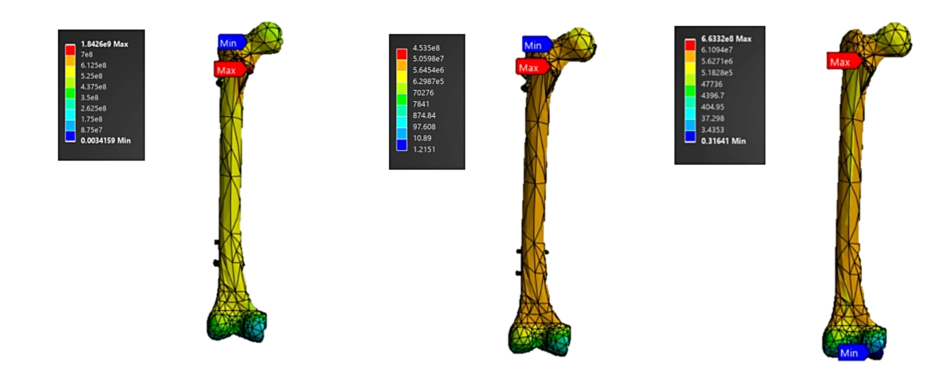
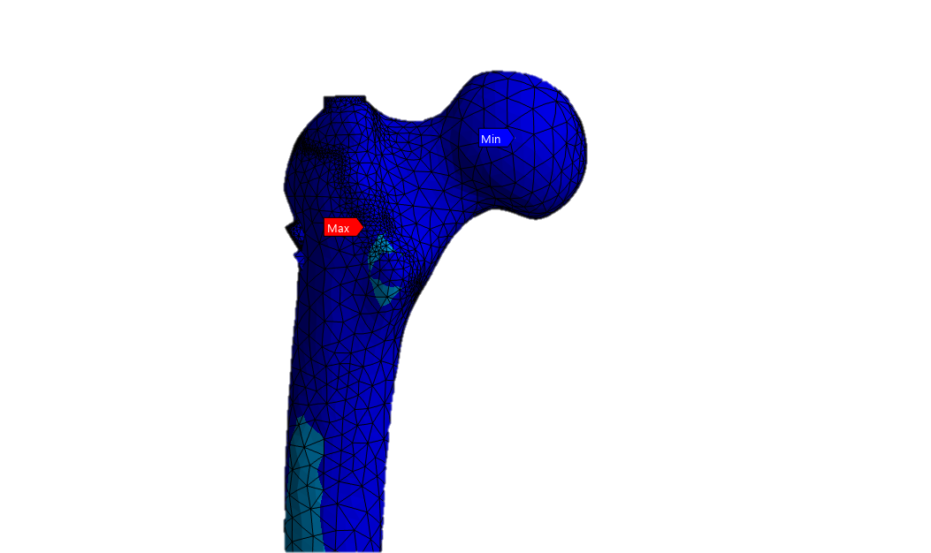
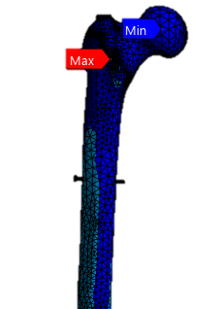
Results
PFN:
75 kg fractured: Implant stress = 1.84 GPa, Bone stress = 760.11 MPa, Average stress = 11.10 MPa
7.5 kg fractured: Implant stress = 453.5 MPa, Bone stress = 122.62 MPa, Average stress = 3.09 MPa
75 kg bonded/healed: Bone stress = 37.33 MPa, Average stress = 6.74 MPa
(a) Fractured – 75 kg (b) Fractured – 7.5 kg (c) Bonded – 75 kg

Slide 20
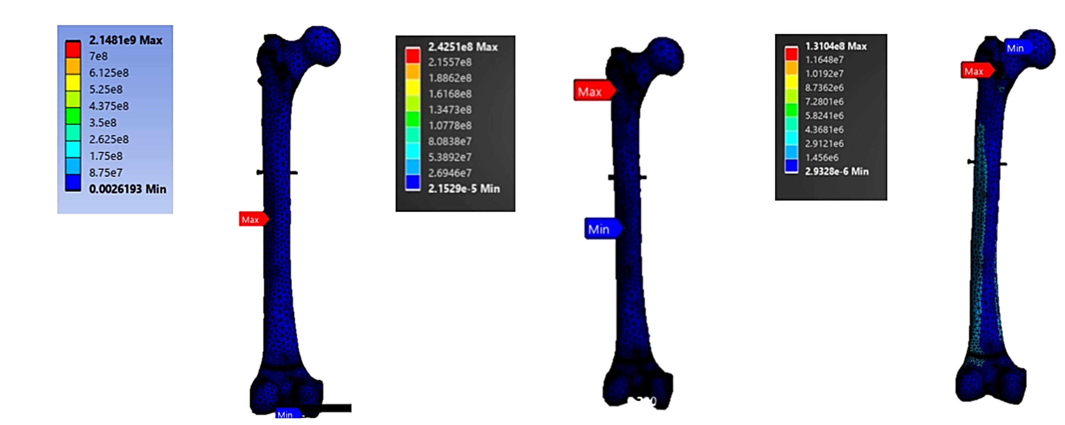
Results
Results
PFNA-II:
75 kg fractured: Implant stress = 1.04 GPa, Bone stress = 2.1481 GPa, Average stress = 13.21 MPa
7.5 kg fractured: Implant stress = 242.51 MPa, Bone stress = 167.74 MPa, Average stress = 1.17 MPa
75 kg bonded/healed: Implant stress = 131.04 MPa, Bone stress = 29.48 MPa
(a) Fractured – 75 kg (b) Fractured – 7.5 kg (c) Bonded – 75 kg

Slide 21
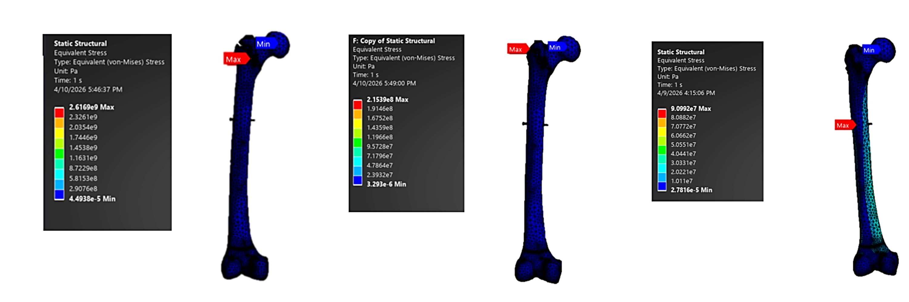
Results
InterTAN:
75 kg fractured: Implant stress = 2.6169 GPa, Average stress = 17.45 MPa
7.5 kg fractured: Implant stress = 215.39 MPa, Bone stress = 62.26 MPa, Average stress = 1.66 MPa
75 kg bonded/healed: Implant stress = 90.99 MPa, Bone stress = 31.65 MPa, Average stress = 7.67 MPa
(a) Fractured – 75 kg (b) Fractured – 7.5 kg (c) Bonded – 75 kg

Slide 22
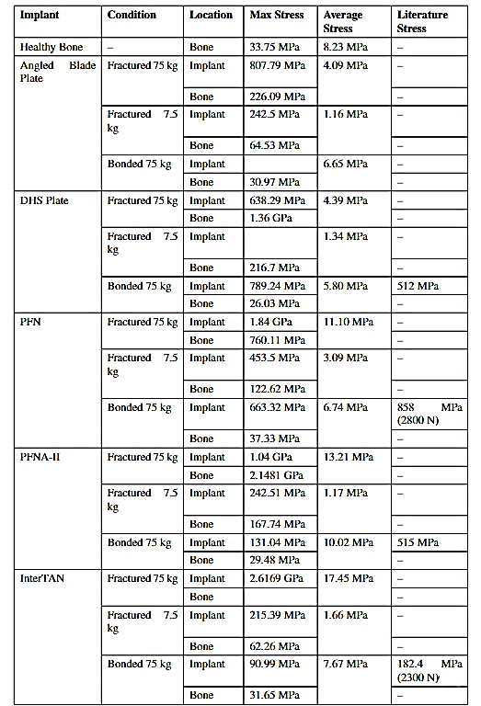
Comparison and Conclusion
Intramedullary Implants:

Slide 23
Comparison and Conclusion
Extramedullary Implants:

Slide 24
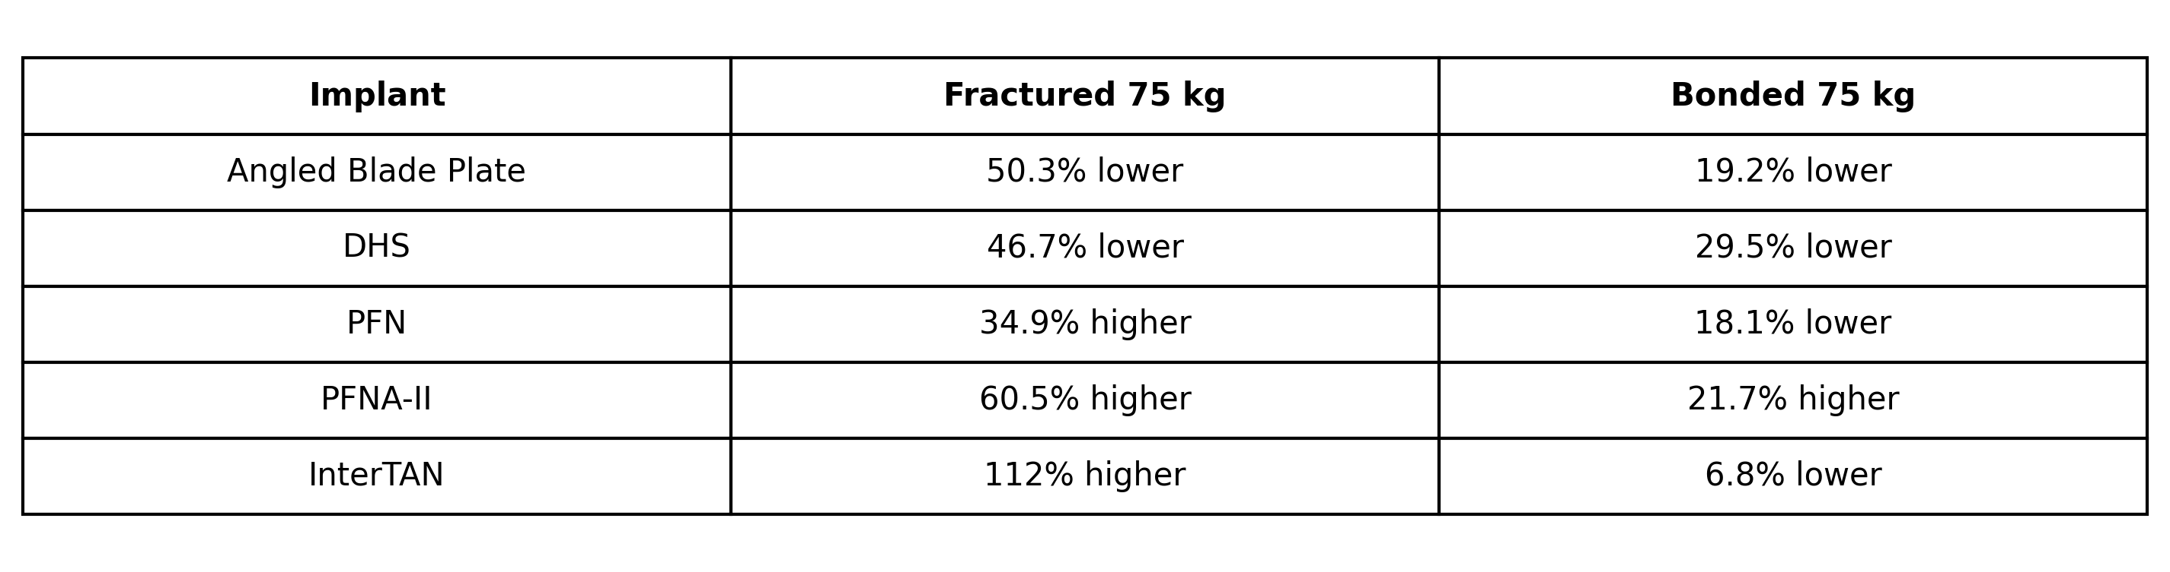
Comparison and Conclusion
FEA was performed on DHS, Angled Blade Plate, PFN, PFNA-II, and InterTAN to compare implant stability and stress distribution in intertrochanteric femur fractures.
Average stress deviation from healthy bone (8.23 Mpa)
InterTAN showed the closest performance to healthy bone in the healed condition (6.8% lower), indicating the best load-sharing capability.
PFNA-II carried higher stresses in fractured conditions, indicating stronger fixation and stability under loading.

Slide 25
Comparison and Conclusion
PFN, PFNA-II and InterTAN (intramedullary nails) showed better load sharing and stability than DHS and Angled Blade Plate (extramedullary implants), with InterTAN performing closest to healthy bone conditions.
The study highlighted that premature full body-weight loading can cause excessive stress and possible implant or bone failure, emphasizing the importance of gradual rehabilitation with assisted support until sufficient healing occurs.

Slide 26
References
References
[1] Tianhao Yang, Faez Noraddin, Baozhe Liu, Zegen Zhang and Hai-Lun Gu; Finite Element Analysis of Implant Selection and Screw Positioning in Proximal Femoral Basicervical Fractures, Article in Scientific Reports, Oct 2025
[2] Huang X, Yu B, Gu Y, Li Z. Biomechanical comparison of dynamic hip screw and Gamma
nail for the treatment of unstable trochanteric fractures: a finite element study. Original
Article, 2017.
[3] Li C-T, Chang C-W, Chen Y-N. Biomechanical analysis of proximal femoral nail
augmented with various screw configurations for proximal femoral fractures. Journal
of Orthopaedics, Volume 73, March 2026, pp. 159–168.
[4] Mustamsir E, Aji AP, Fernando A; Comparative evaluation of proximal femoral nail anti-rotation versus dynamic hip screw for stable intertrochanteric femoral fractures: A meta-analysis of clinical outcomes, Journal of Musculoskeletal Surgery and Research, June 2024, Vol 8

Slide 27
[5] Rogalski, Martelli, Pandy, Kersh. Role of muscle forces on strain distributions in the
proximal femur. Journal of Biomechanics, 2025.
[6] Gao-Xiang Yuan, Yu-Hui Shen, Bo Chen, Wei-Bin Zhang; Biomechanical comparison of internal fixations in osteoporotic intertrochanteric fracture, Journal of Saudi Med J 2012; Vol. 33 (7)
[7] Sandeep Rathor, Rashmi Uddanwadiker, Nandram Saryam and Ashutosh Apte; Effective Treatment of Femur Diaphyseal Fracture with Compression Plate – A Finite Element and In Vivo Study Comparing the Healing Outcomes of Nailing and Plating, Article in Indian Journal of Orthopaedics, Accepted November 2022
[8] Ansys Granta EduPack Software

Slide 28
Thank you
10 / 10

